Slide 1
ECON 6082 Final Project
LAM Pui King 3035870595 CHAN Mok Fan 3035872189 JIANG Rui 3035869637

Slide 2
Agenda
Background
Research Questions
Methodology
Results

Slide 3
1. Background
Anti-Extradition Law Amendment Bill Movement (反逃犯條例修訂運動)
There has been an Anti-Extradition Law Amendment Bill Movement during 2019. Schools are shrinking as parents feared "brainwashing" "patriotic" education be implemented, and tens of thousands applied for British National (Overseas) Visa after the London Government unveiled a new immigration path for passport holders.
The establishment of the Innovation and Technology Bureau (“ITB”)
In the past decade, the Innovation and Technology industry is one of the key economic areas that the Hong Kong Government seeks to further develop. In order to promote and support the industry, ITB was formally established on 20 Nov 2015. It is responsible for formulating holistic policies relating to innovation and technology; strengthening the coordination among the Government, industry, academia and research sectors; and expediting the development of innovation, technology and related industries in Hong Kong.

Slide 4

2. Research Questions
What was the situation of students who discontinued their studies over the past ten years? Any differences between the level of study and school?
How was the employment situation of Full-time Graduates over the past decade among universities? Were there any significant changes in terms of employment preference? What were the most popular industries our graduates usually work with?
Were there any positive changes for that industry in terms of graduate employment preference after the setting up of ITB?
3. Methodology

Slide 5
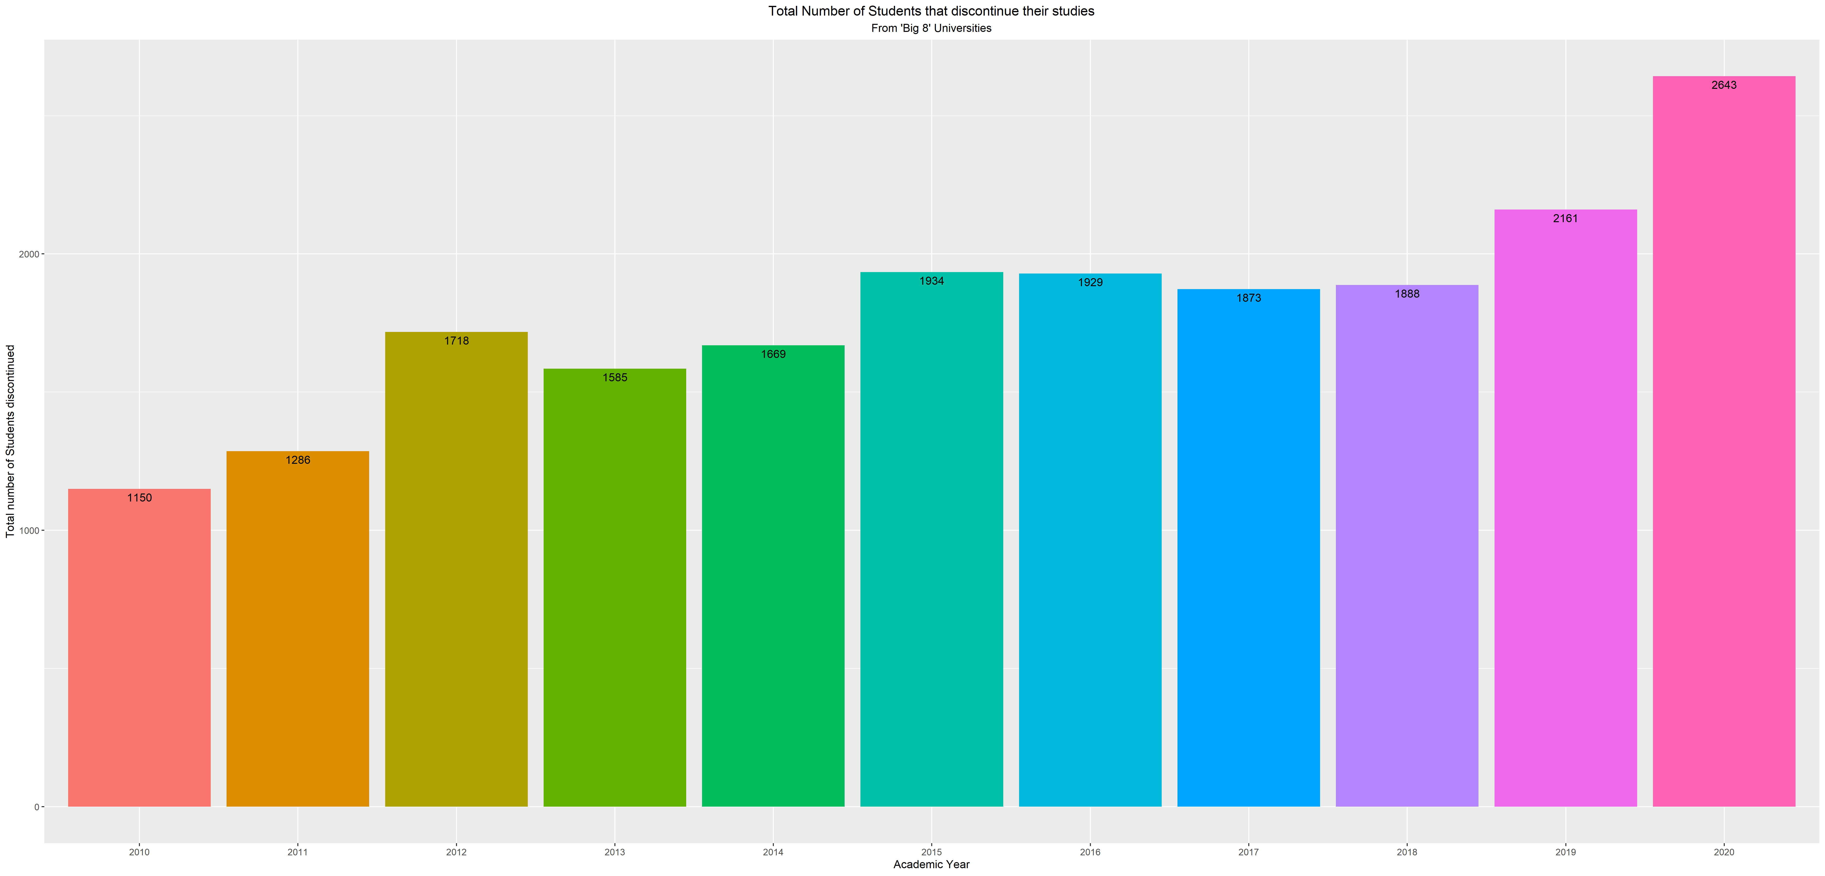
4. Results
Graph 1. Total Number of students that discontinued their studies by Year
X-axis: timeline (from 2010 to 2020)
Y-axis: the total number of discontinuity in each year
Result:
there was an increasing trend in terms of the total number of students that discontinued Undergraduates’ studies from 2018 to 2020

Slide 6
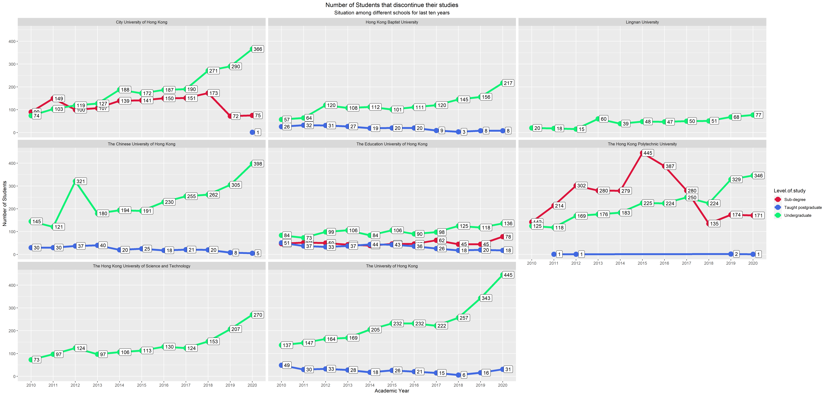
4. Results
Graph 2. Number of Students that Discontinue Their Studies by Year and by University
X-axis: timeline (from 2010 to 2020)
Y-axis: the total number of discontinuity in each year
Result:
HKU had the largest number of discontinuity of undergraduates (445) and CUHK was in the second largest position (398) in 2020.

Slide 7
4. Results
What was the situation of students who discontinued their studies over the past ten years? Any differences between the level of study and school?
How was the employment situation of Full-time Graduates over the past decade among universities? Were there any significant changes in terms of employment preference? What were the most popular industries our graduates usually work with?
Were there any positive changes for that industry in terms of graduate employment preference after the setting up of ITB?
Conclusion on question 1:
Anti-Extradition Law Amendment Bill Movement may be a critical factor of the increasing discontinuity of Undergraduates from 2018 to 2020. Moreover, HKU and CUHK may be affected most in terms of undergraduates’ discontinuity.

Slide 8
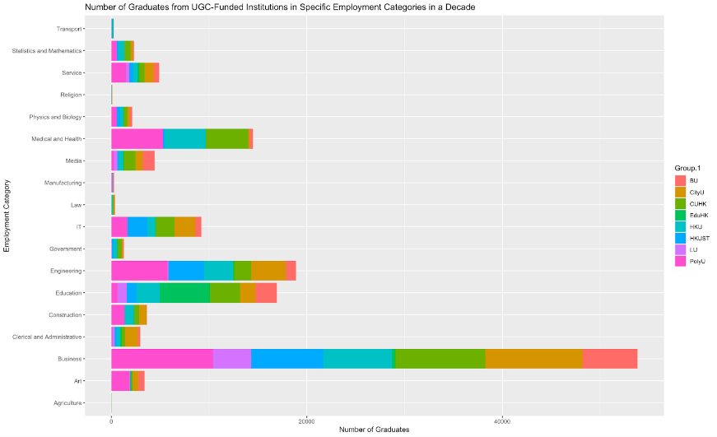
4. Results
Graph 3. Number of Graduates from UGC-Funded Institution in Special Employment Categories in past Decade
X-axis: Total number of graduates being employed in certain categories in the past decade
Y-axis: Employment Categories
Result:
Business professionals have many features that attract graduates, with more than 30,000 (25%) of the total samples who are employed in this field. Almost 20,000 (9.5%) of them cite engineers as another major employment attraction and chose to work in this area.

Slide 9
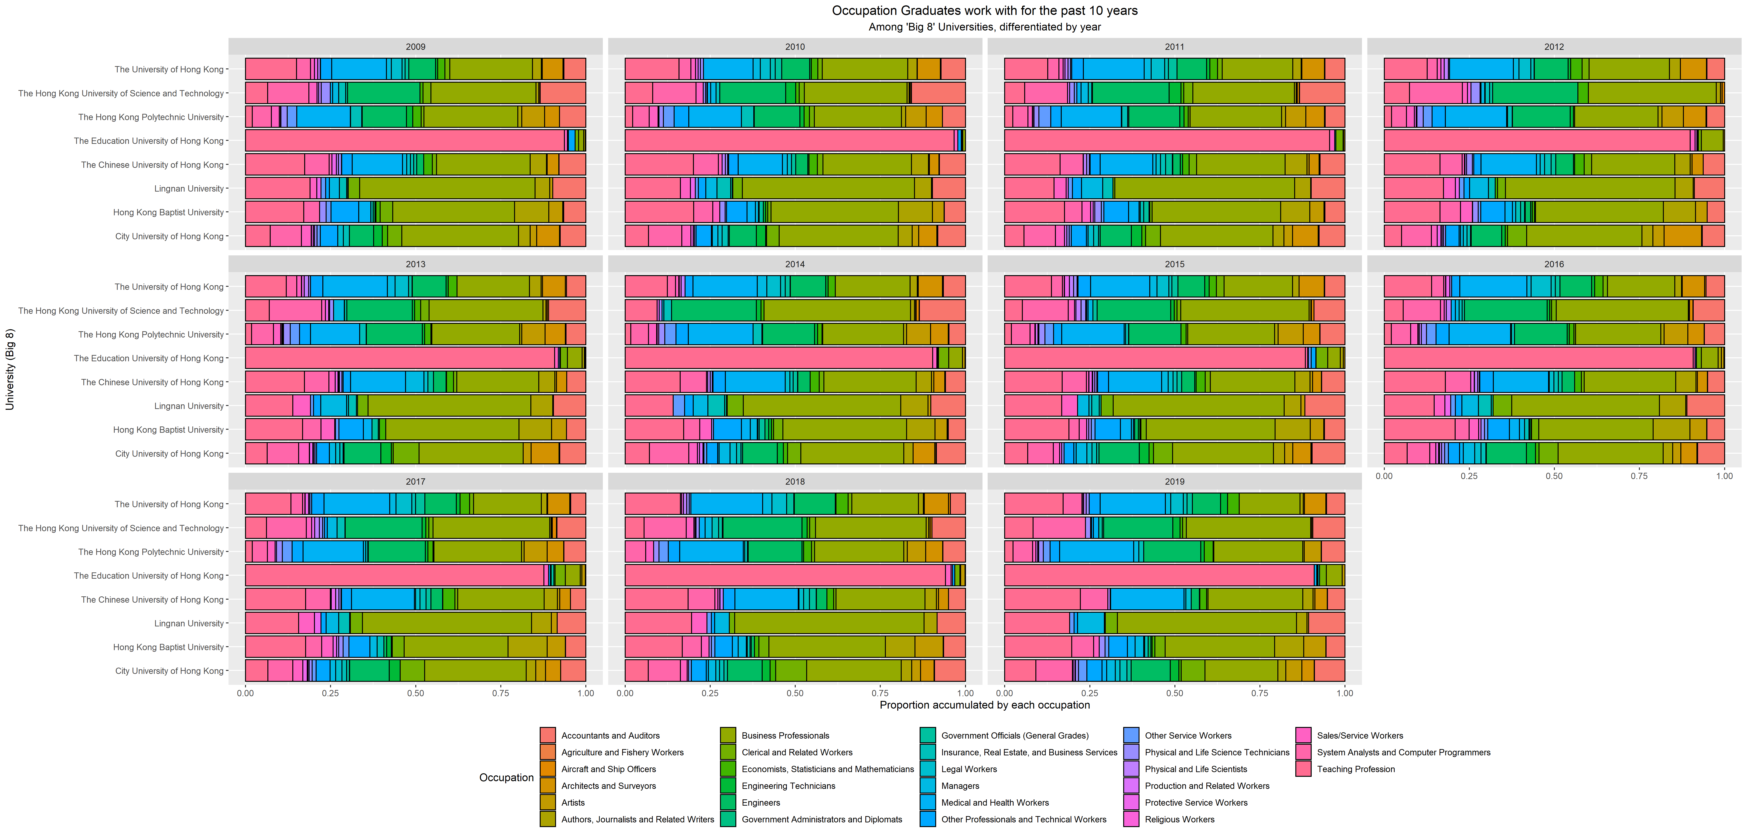
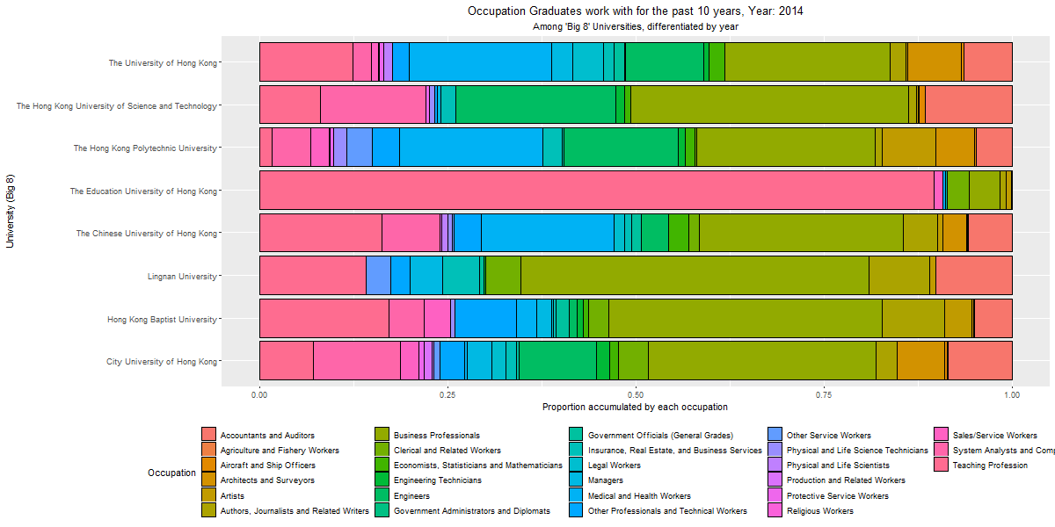
4. Results
Graph 4. Number of Graduates from UGC-Funded Institution in Special Employment Categories in past Decade
X-axis: UGC-Funded Institution
Y-axis: Percentage of graduates that being employed in each employment category
Result:
The graph indicated the biggest proportion of graduates worked in the business sector for most of the universities except for graduates from EduHK.

Slide 10
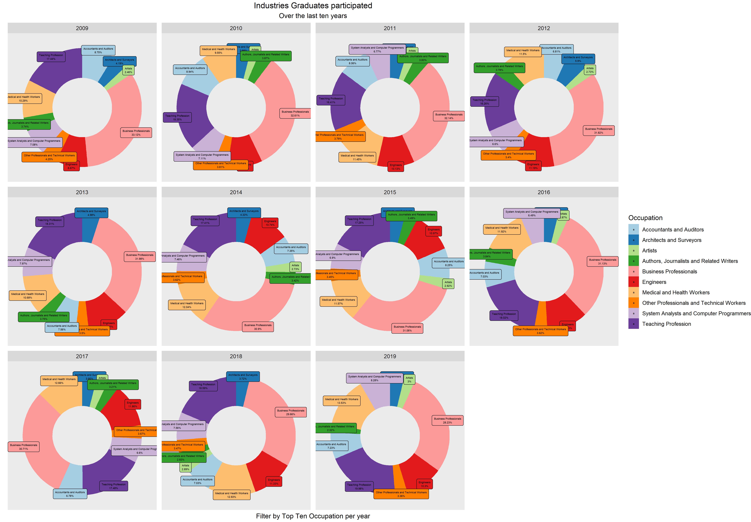
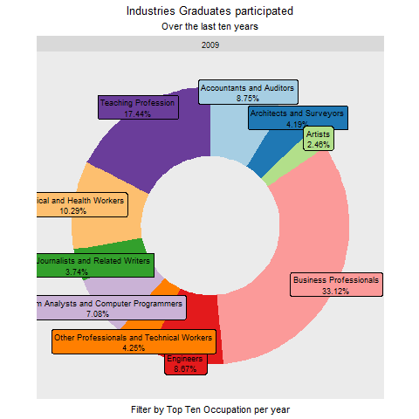
4. Results
Graph 5. Number of Graduates from UGC-Funded Institution in Special Employment Categories by Year
Result:
According to the graph, it is shown that business professional is the most competitive career in every single year. It provided an offer to one-fourth of the whole university graduates yearly.
Conversely, there were only around 6% of graduates who were going to the system and computer programming field yearly.

Slide 11
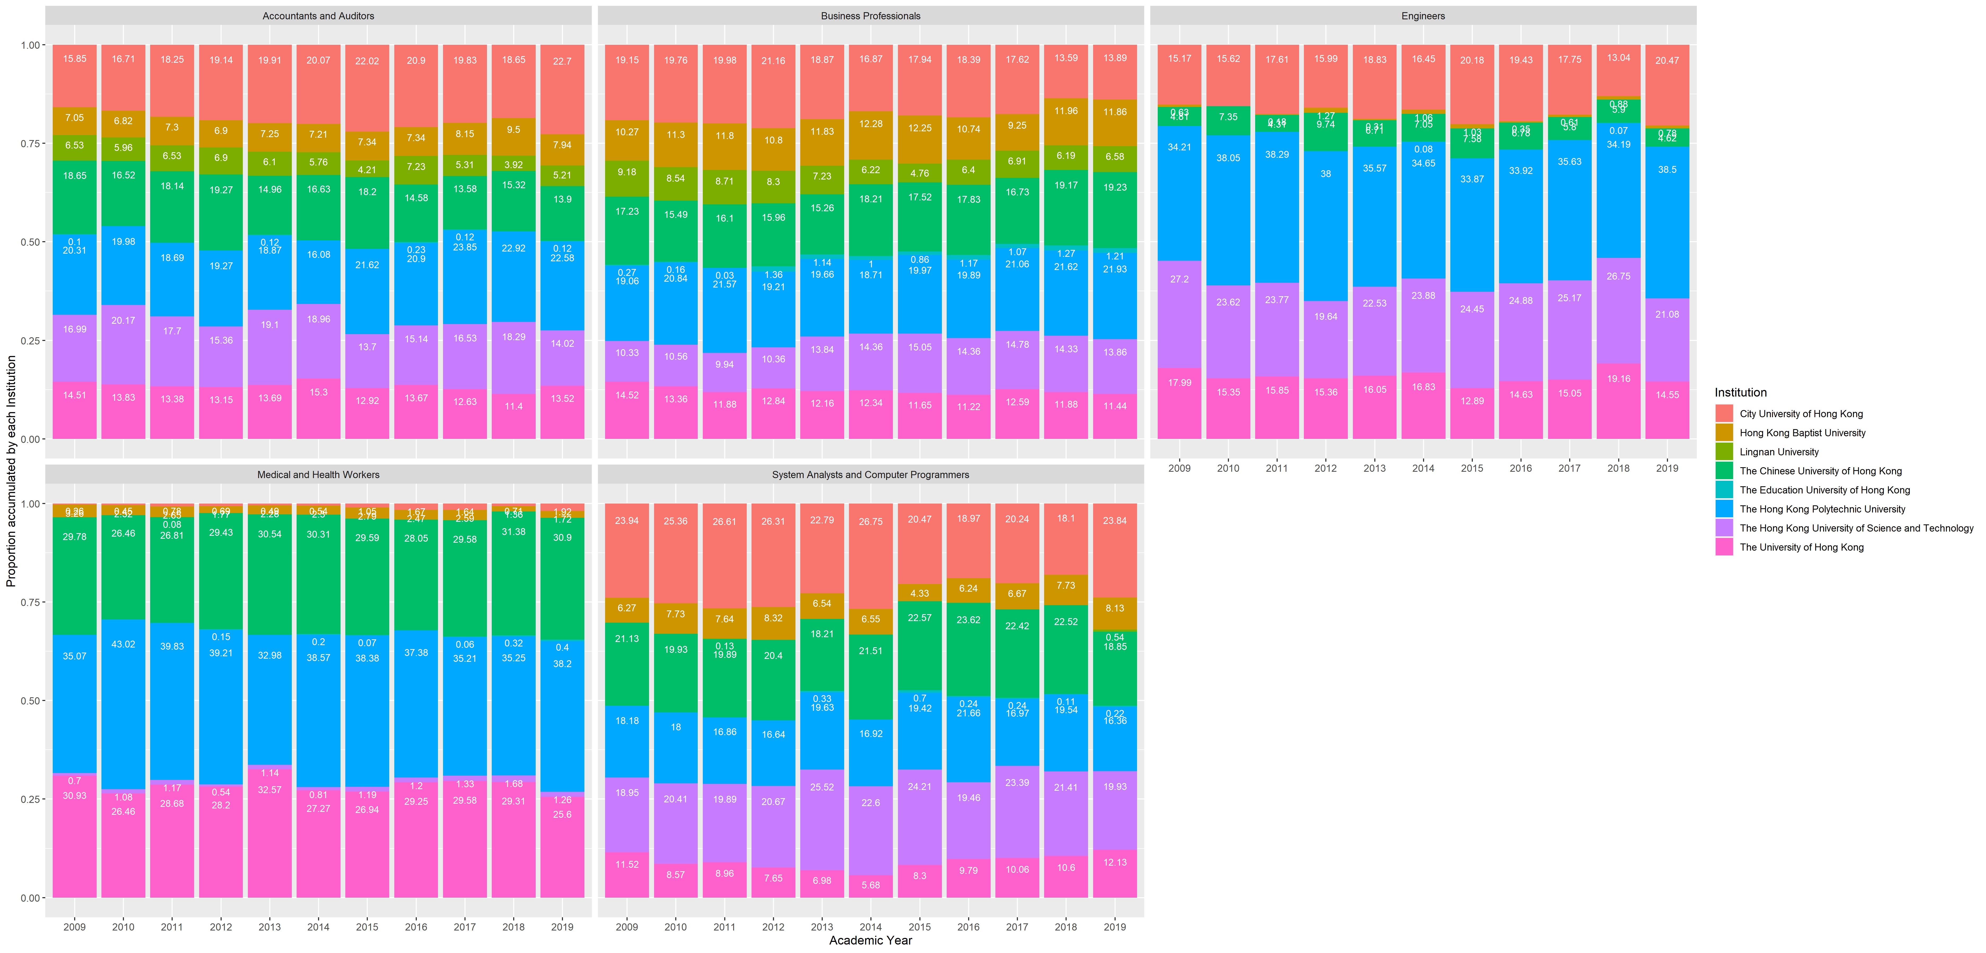
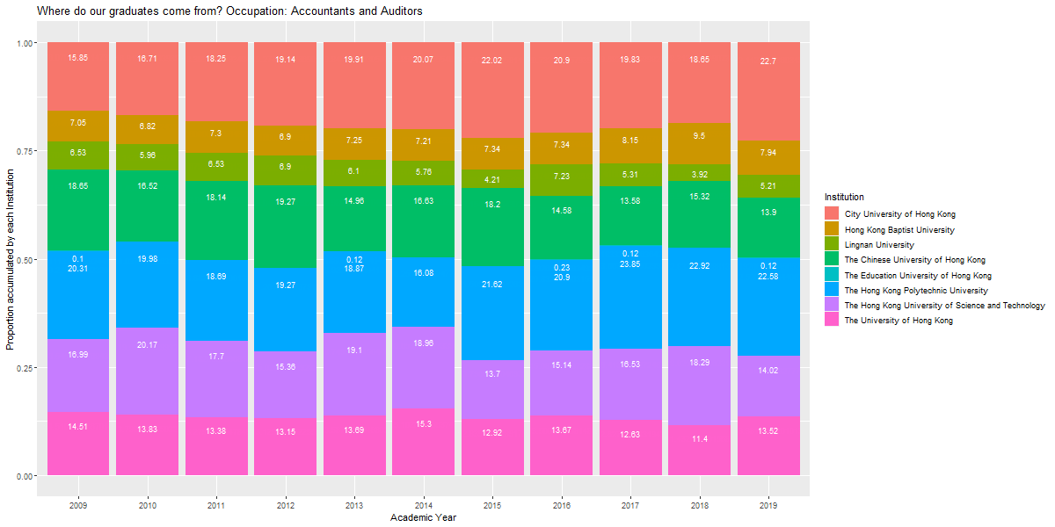
4. Results
Graph 6. Percentage of Total Number of Graduates of the Top-5 Employment Categories by University
X-axis: Timeline ( from 2019 to 2019)
Y-axis: Percentage of total number of graduates
Result:
The graph features the top 5 industries most graduates work in and indicates which university these graduates came from. In terms of business professionals, most of the graduates are from PolyU (over 21%), CUHK (over 19%), CityU (over 13%), and HKUST (over 13%).

Slide 12
4. Results
What was the situation of students who discontinued their studies over the past ten years? Any differences between the level of study and school?
How was the employment situation of Full-time Graduates over the past decade among universities? Were there any significant changes in terms of employment preference? What were the most popular industries our graduates usually work with?
Were there any positive changes for that industry in terms of graduate employment preference after the setting up of ITB?
Conclusion on question 2:
Business professionals are the most fundamental and competitive career choice in the past decade. There were over 25% of total graduates selected it as their first priority. Meanwhile, in this field, most of the graduates are from PolyU (over 21%), CUHK (over 19%), CityU (over 13%), and HKUST (over 13%).

Slide 13
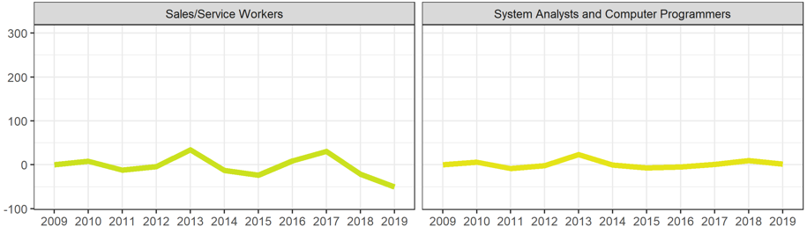
4. Results
Graph 7. Percentage Change of Employment in each Category by Year
X-axis: timeline (from 2009 to 2019)
Y-axis: percentage change of Employment in each Category
Result:
This Graph on the left illustrates that the percentage change in terms of the number of graduates employed by IT companies before and after 2015 was 0.

Slide 14
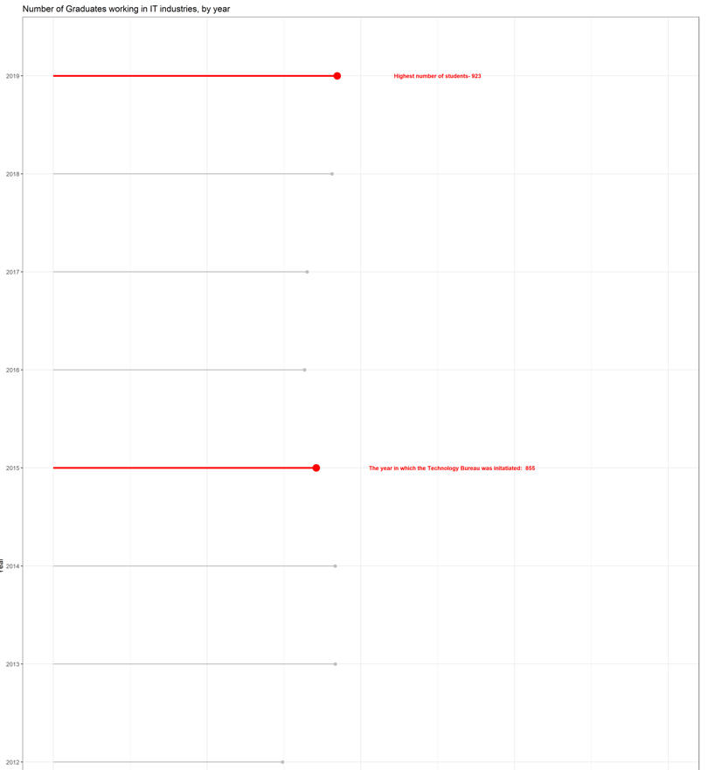
4. Results
Graph 8. Number of Employment in IT Industry by Year
X-axis: percentage change of Employment in each Category
Y-axis: timeline (from 2012 to 2019)
Result:
This Graph also wants to show that the percentage change in terms of the number of graduates employed by IT companies before and after 2015 was 0.

Slide 15
4. Results
What was the situation of students who discontinued their studies over the past ten years? Any differences between the level of study and school?
How was the employment situation of Full-time Graduates over the past decade among universities? Were there any significant changes in terms of employment preference? What were the most popular industries our graduates usually work with?
Were there any positive changes for that industry in terms of graduate employment preference after the setting up of ITB?
Conclusion on question 3:
there was no significant change in terms of the number of graduates employed by IT companies before and after 2015, in which the ITB was formally established. As a result, it seems there are not any easy-capture impacts on the IT industry after the establishment of ITB.

Slide 16
Thank You !

